Slide 1
Weekly Report
Dian Hanifudin Subhi

Slide 2
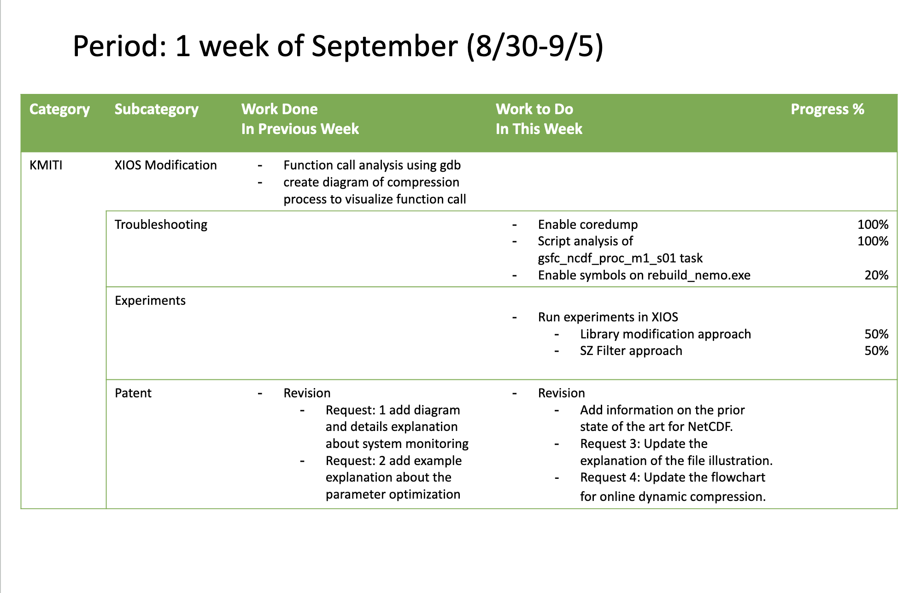
Weekly report

Slide 3
Summary of work this week
The requests of patent update
Request 3: Update the explanation of the file illustration.
Request 4: Update the flowchart for online dynamic compression.
Additional request: Add information on the prior state of the art for NetCDF.
The SZ integration compression has been partially successful for certain variables.
Skip the compression of unsupported variables in NEMO models.
Both strategies fail at the gsfc_ncdf_proc_m1_s01 task, several approaches have been tried to find the root caused
Add verbosity to the log to capture exception messages in the Python script for the gsfc_ncdf_proc_m1_s01 task.
Update the Linux kernel configuration to enable core dumps to be saved to a file.
Verify that the -g compilation flag is set for the Fortran program in the FCM configuration.

Slide 4
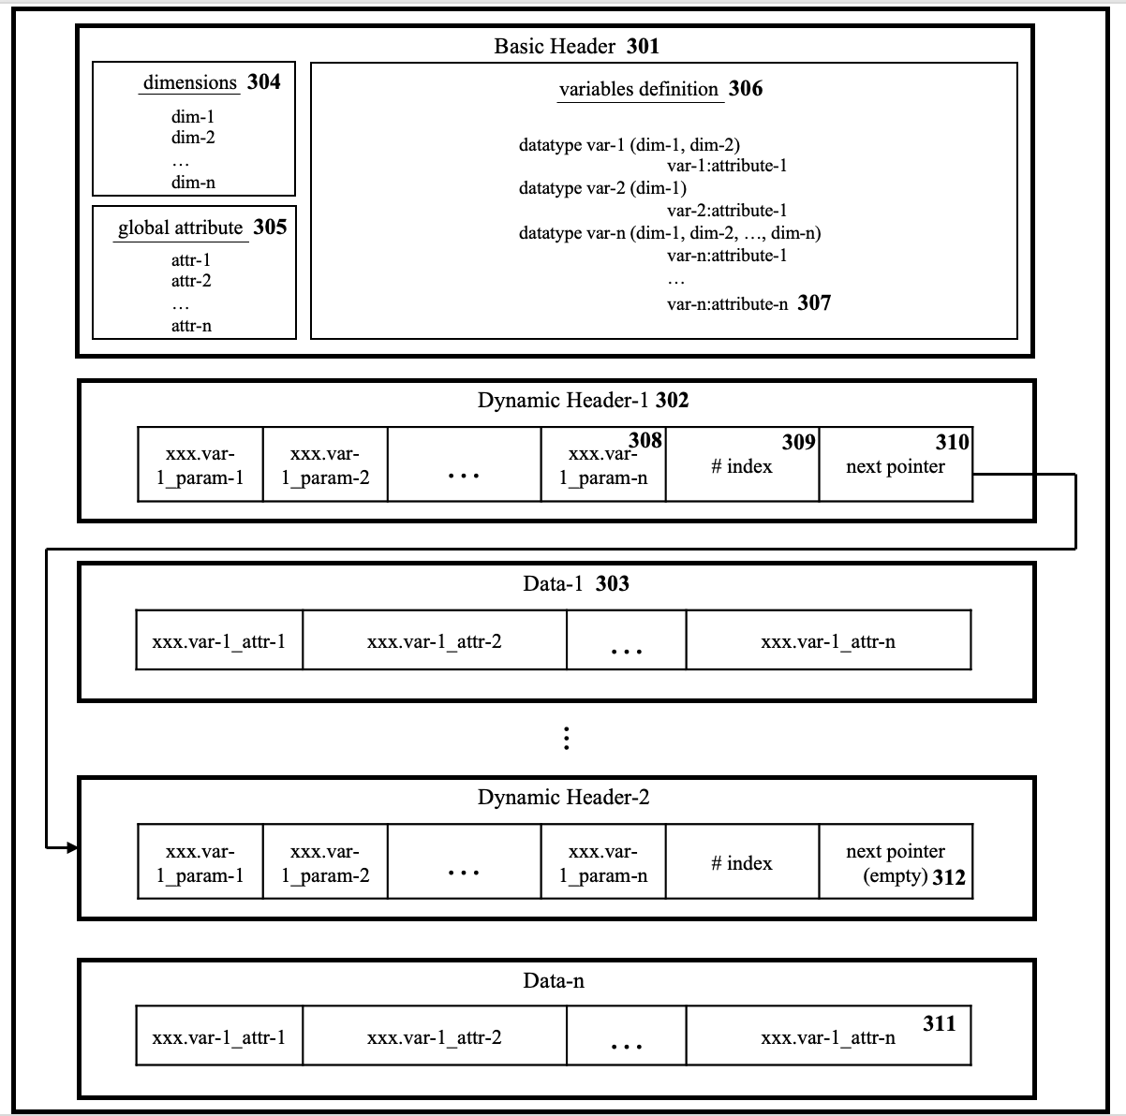
Patent Update
Update the file illustration, one dynamic header -> one variable

Slide 5
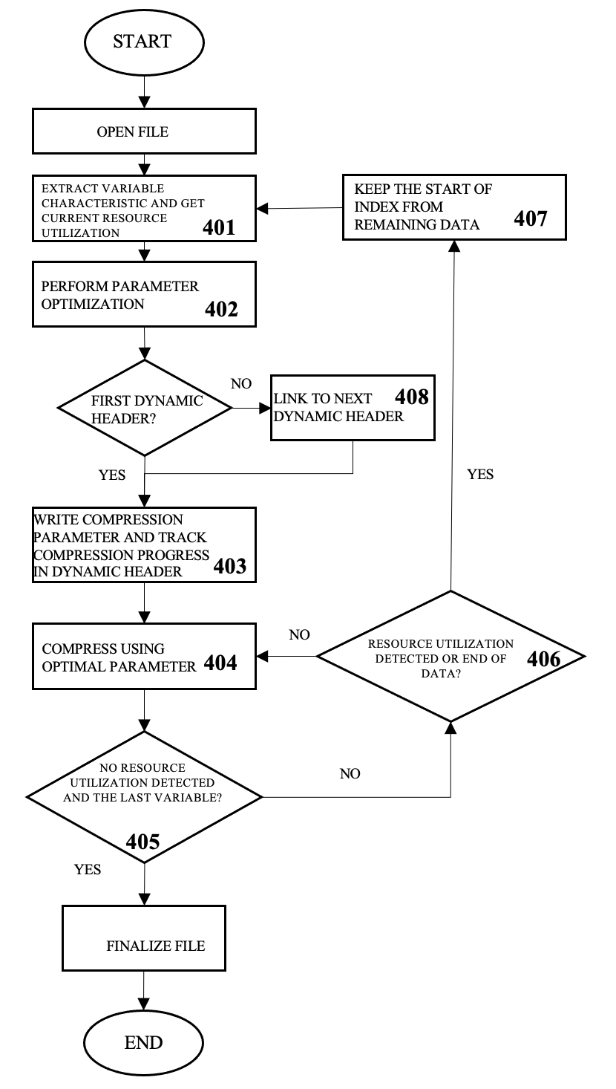
Patent Update
Update the flowchart for online dynamic compression.
Update the condition when stop the online compression process
Update the process when track the remaining data

Slide 6
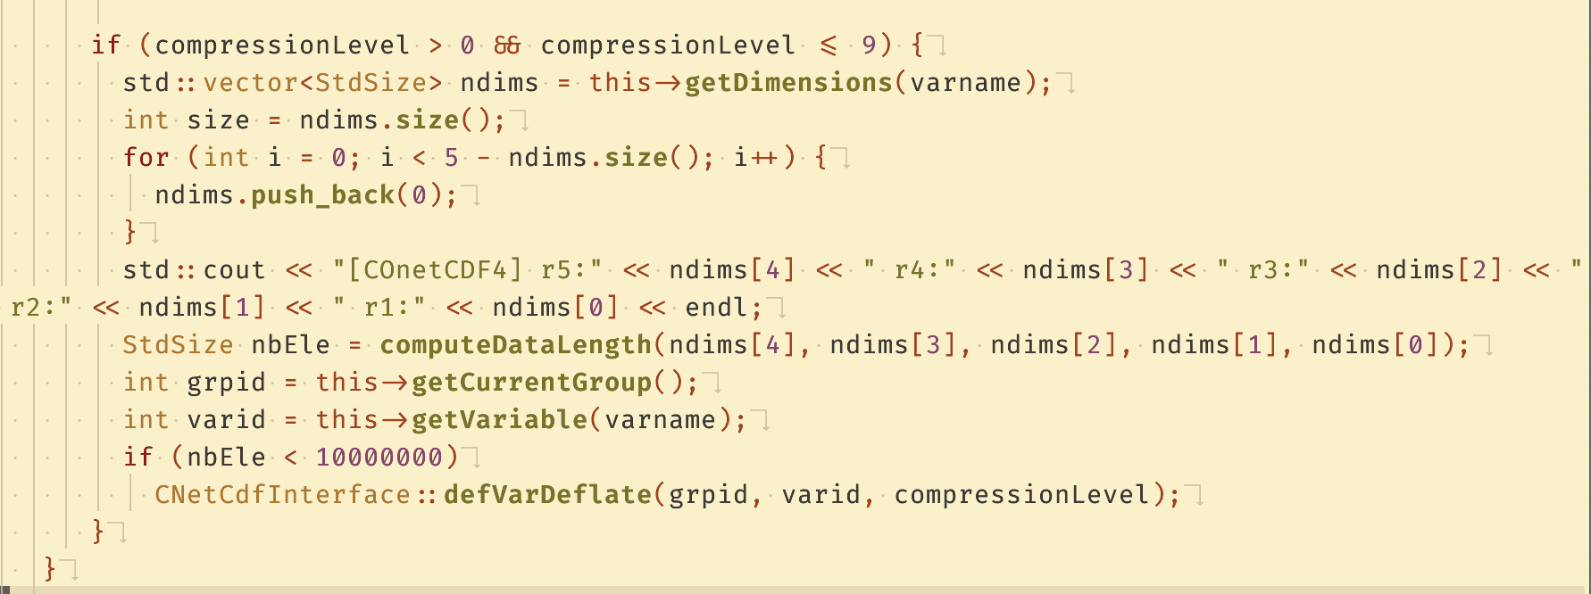
XIOS Modification
Add feature to skip compression for unsupported variables
The condition to skip SZ compression has been added to XIOS before call the compress process
The condition using computeDataLength function provided by SZ library

Slide 7
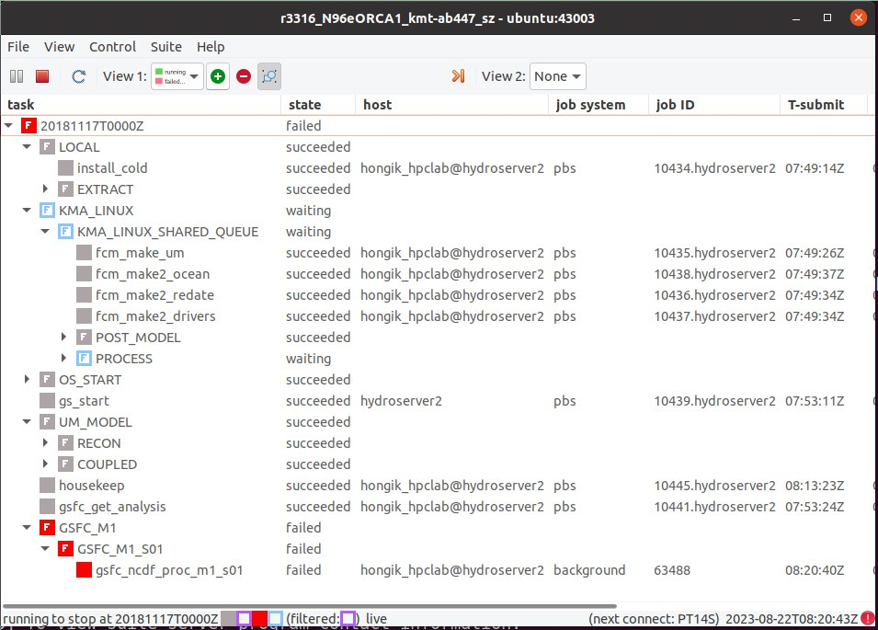
XIOS Modification
The experiment failed during the final task when executed in the Low GloSea6 environment.

Slide 8
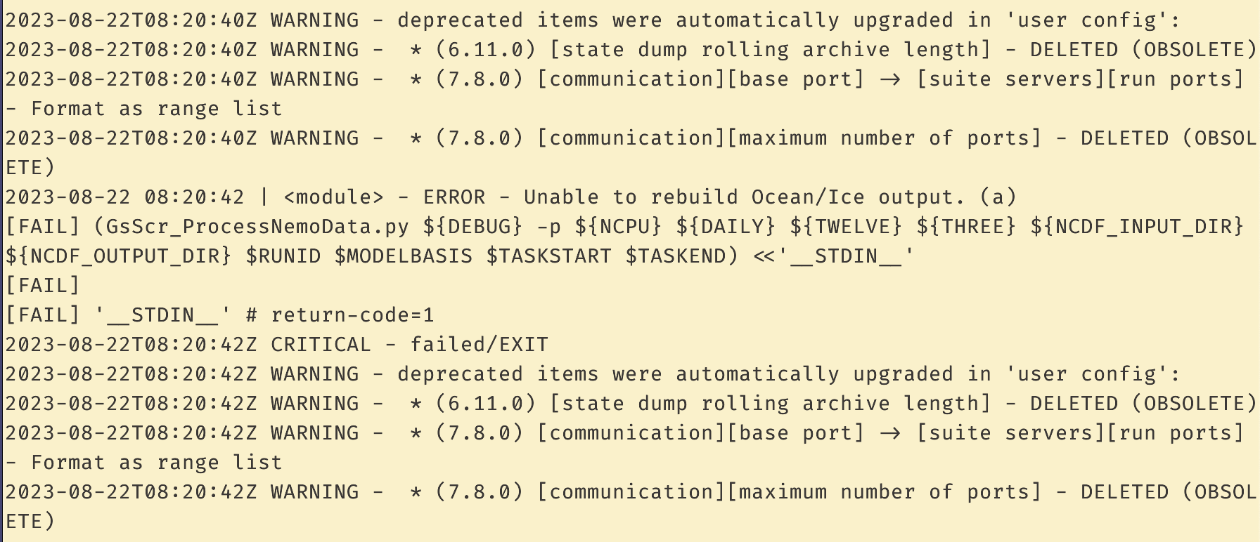
Troubleshooting
The gsfc_ncdf_proc_m1_s01 task logging information
The log for the task gsfc_ncdf_proc_m1_s01 doesn't provide much information about errors. Although logging was added to capture the actual exception messages, no new log entries have been recorded.

Slide 9
Troubleshooting
Updating Kernel configuration to enable core dump into file
Update the /proc/sys/kernel/core_pattern file to specify the directory for core dump storage.
Set the resource limit in /etc/security/limits.conf to define the maximum size of the generated core dump files. By default, the size is set to 0, which prevents core dumps from being generated.

Slide 10
Troubleshooting
Script Analysis at gsfc_ncdf_proc_m1_s01 task
The gsfc_ncdf_proc_m1_s01 task is defined to call Python script GsScr_ProcessNemoData.py
The GsScr_ProcessNemoData.py perform post processing on the model integration to combine the separate file into single model output file.
The script depends on internal Python script module, glosea.processing.netcdf

Slide 11
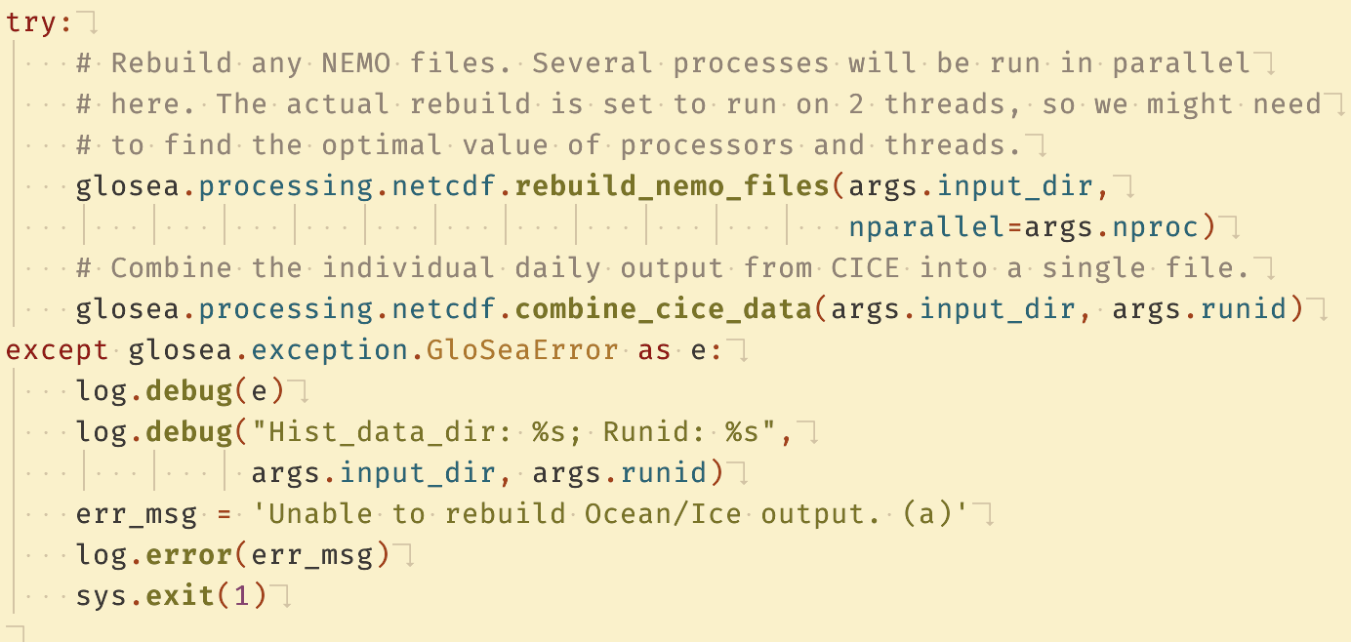
Troubleshooting
Script Analysis at gsfc_ncdf_proc_m1_s01 task
The module is designed to combine outputs from the NEMO and CICE models.

Slide 12
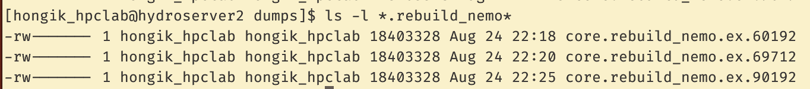
Troubleshooting
Script Analysis at gsfc_ncdf_proc_m1_s01 task
The module is defined at share/fcm_make_glosea/build/bin/glosea/processing/netcdf.py
The script calls the rebuild_nemo.exe program, which is written in Fortran and defined in the rebuild_nemo.f90 file.
A core dump for rebuild_nemo.exe can be generated in the /var/dumps directory.

Slide 13
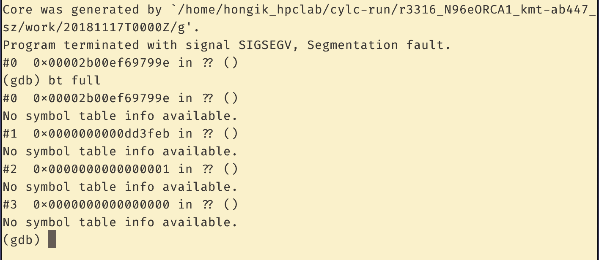
Troubleshooting
No symbol table is available for rebuild_nemo.exe when checked using gdb.

Slide 14
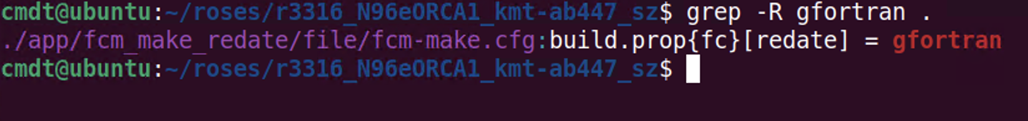
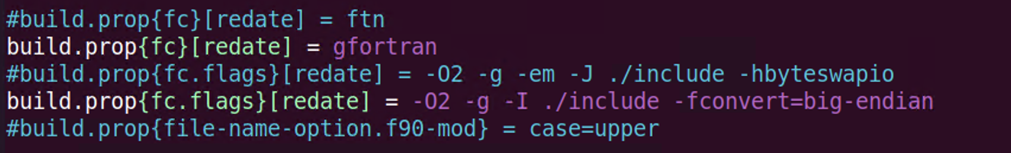
Troubleshooting
The fortran compilation options in ROSE
Fortran code is compiled using the gfortran compiler.
Configuration settings are defined in the file located at app/fcm_make_redate/file/fcm-make.cfg, and can be found using the "grep gfortran" pattern.
Debugging symbols can be enabled with the '-g' flag. However, these symbols are not traceable when checked using gdb.

Slide 15
Conclusion
The experiment failed during the final task when executed in the Low GloSea6 environment after skipping compression for unsupported variables.
Further investigation is needed to configure debugging symbols and enhance the detail of error messages.

Slide 16
Action items
Find the configuration to enable symbols in rebuild_nemo.exe for debugging purposes.

